Slide 1
ADOPTION ASSIST
SEBIN PULLAKATT - 001059017
ISHANI BOSE -001302595
SRIJONI BISWAS - 001057367

Slide 2
PROBLEM OVERVIEW
Every year thousands of families plan on adopting a child while another thousands plan on aborting a pregnancy. Questions such as Should I adopt a newborn? How can I adopt? Cross the minds of hopeful parents while those who want to abort either cannot afford a baby, are sometimes too young or have relationship problems. This could be overcome, from one helping hand to another.

Slide 3
SOLUTION
This application will allow families who wish to adopt get in touch with mothers who wish to go ahead with their pregnancy through proper counseling and monetary support from the hospital and bank go through with their pregnancy. It also helps pregnant mothers to make an informed decision about their adoption or abortion before doing so.

Slide 4
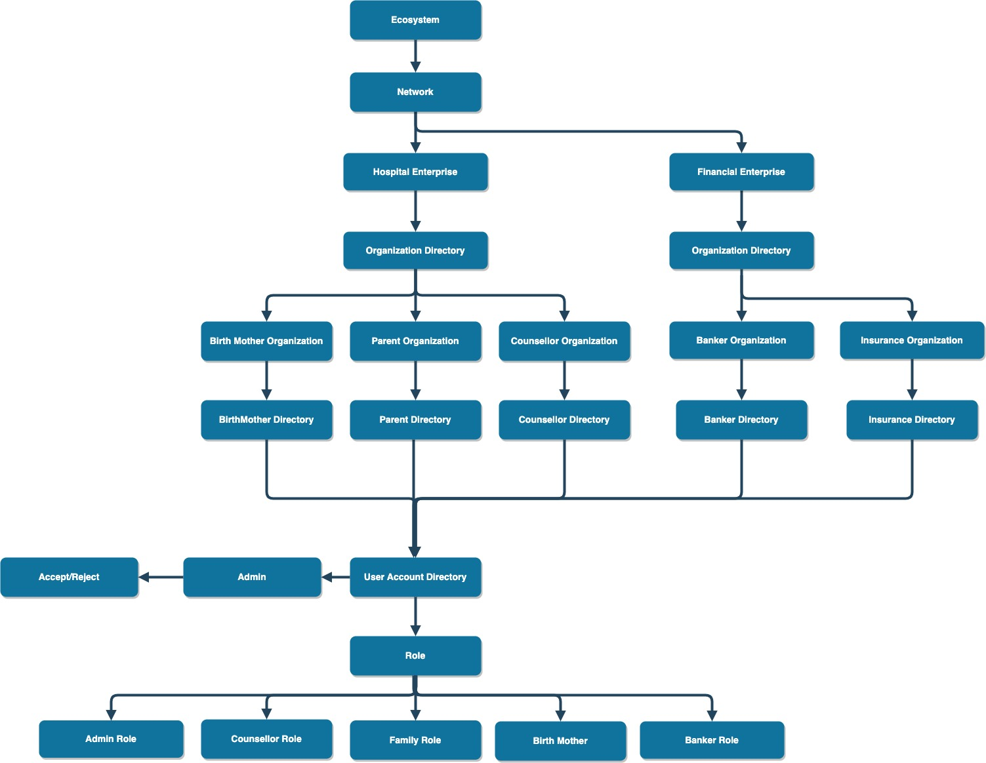

Slide 5
Functionalities
Birth Mother allotment to Parents after seeking proper Counselling
Channelising loan from Bank Enterprises for Birth Mother for proper support
Seeking Insurance from Bank Enterprises for Birth Mother
Seeking funds from alloted parents for Birth Mother
Providing Information to Birth Mother about the different stages in Pregnancy

Slide 6
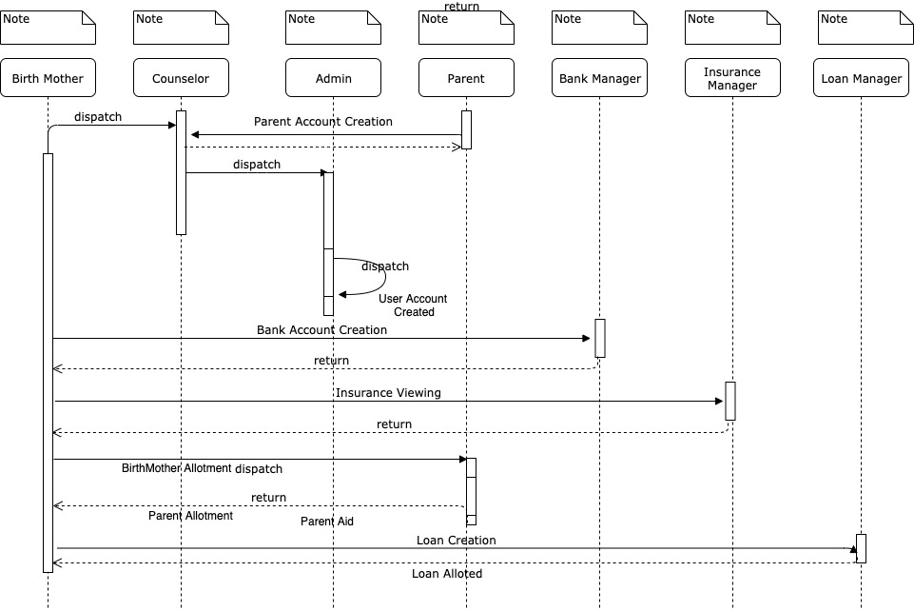

Slide 7
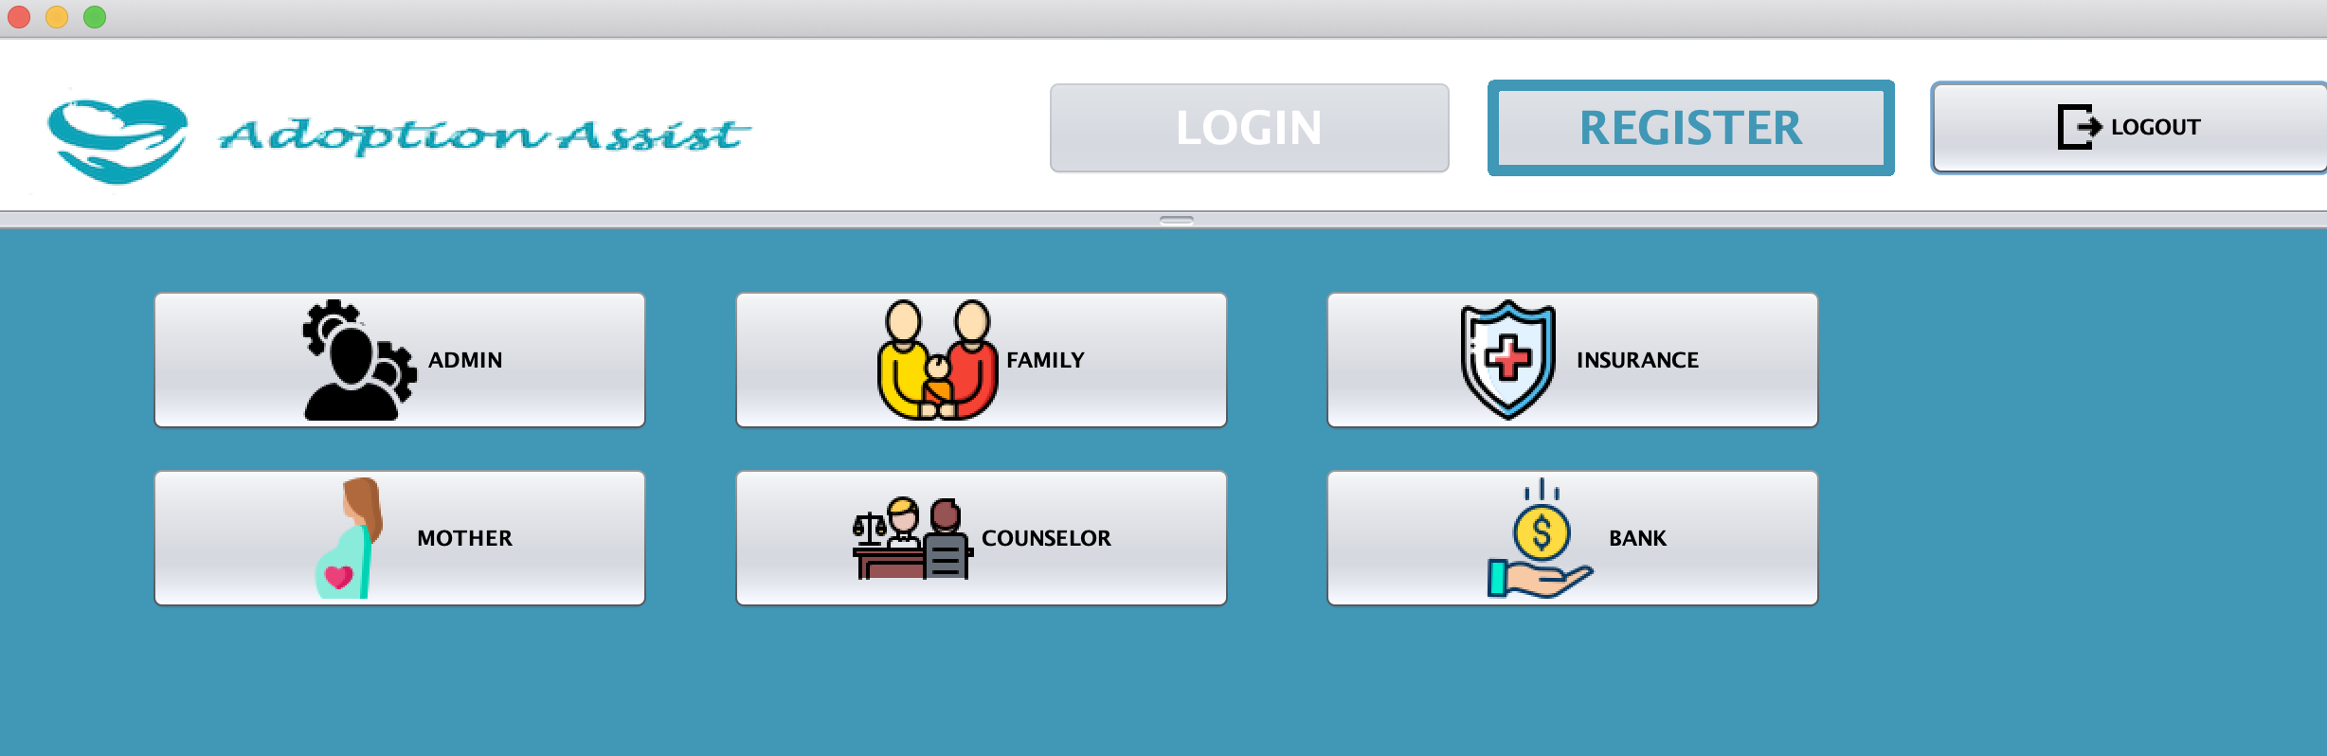
Primary Stakeholders

Slide 8
Birth Mother
In many early pregnant Mothers, they’re unsure about undergoing the abortion process or not. To help our Birth Mother make an informed decision, we chanelise them into our system after a counsellor visit
After the counselor visit if they wish to abort the child, they move into the Hospital Track, otherwise our Hospital Admin creates her account and she remains inside the system
She is further insisted on Updating her Profile, in our system, which requires her to create a Bank ensure with the amount of existing funds she has
During her 38-40 weeks pregnancy, she is also informed about the Baby Size and the precautions to be taken

Slide 9
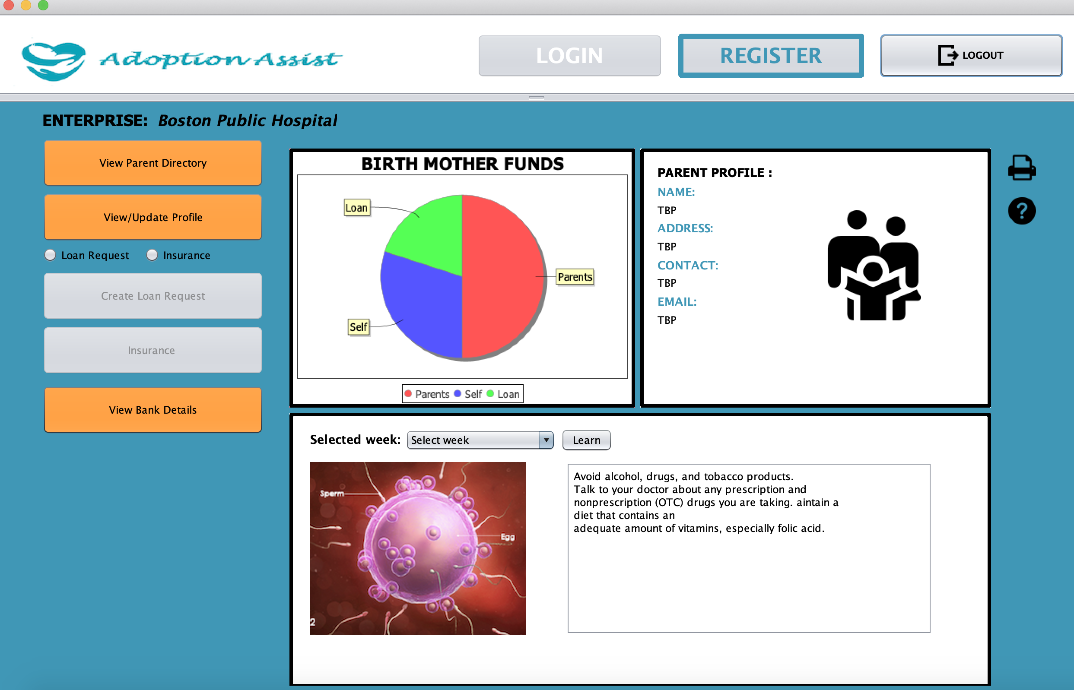

Slide 10
Parent
Adopted parents to Birth Mother
Provides Financial Support to Birth Mother during her application process

Slide 11
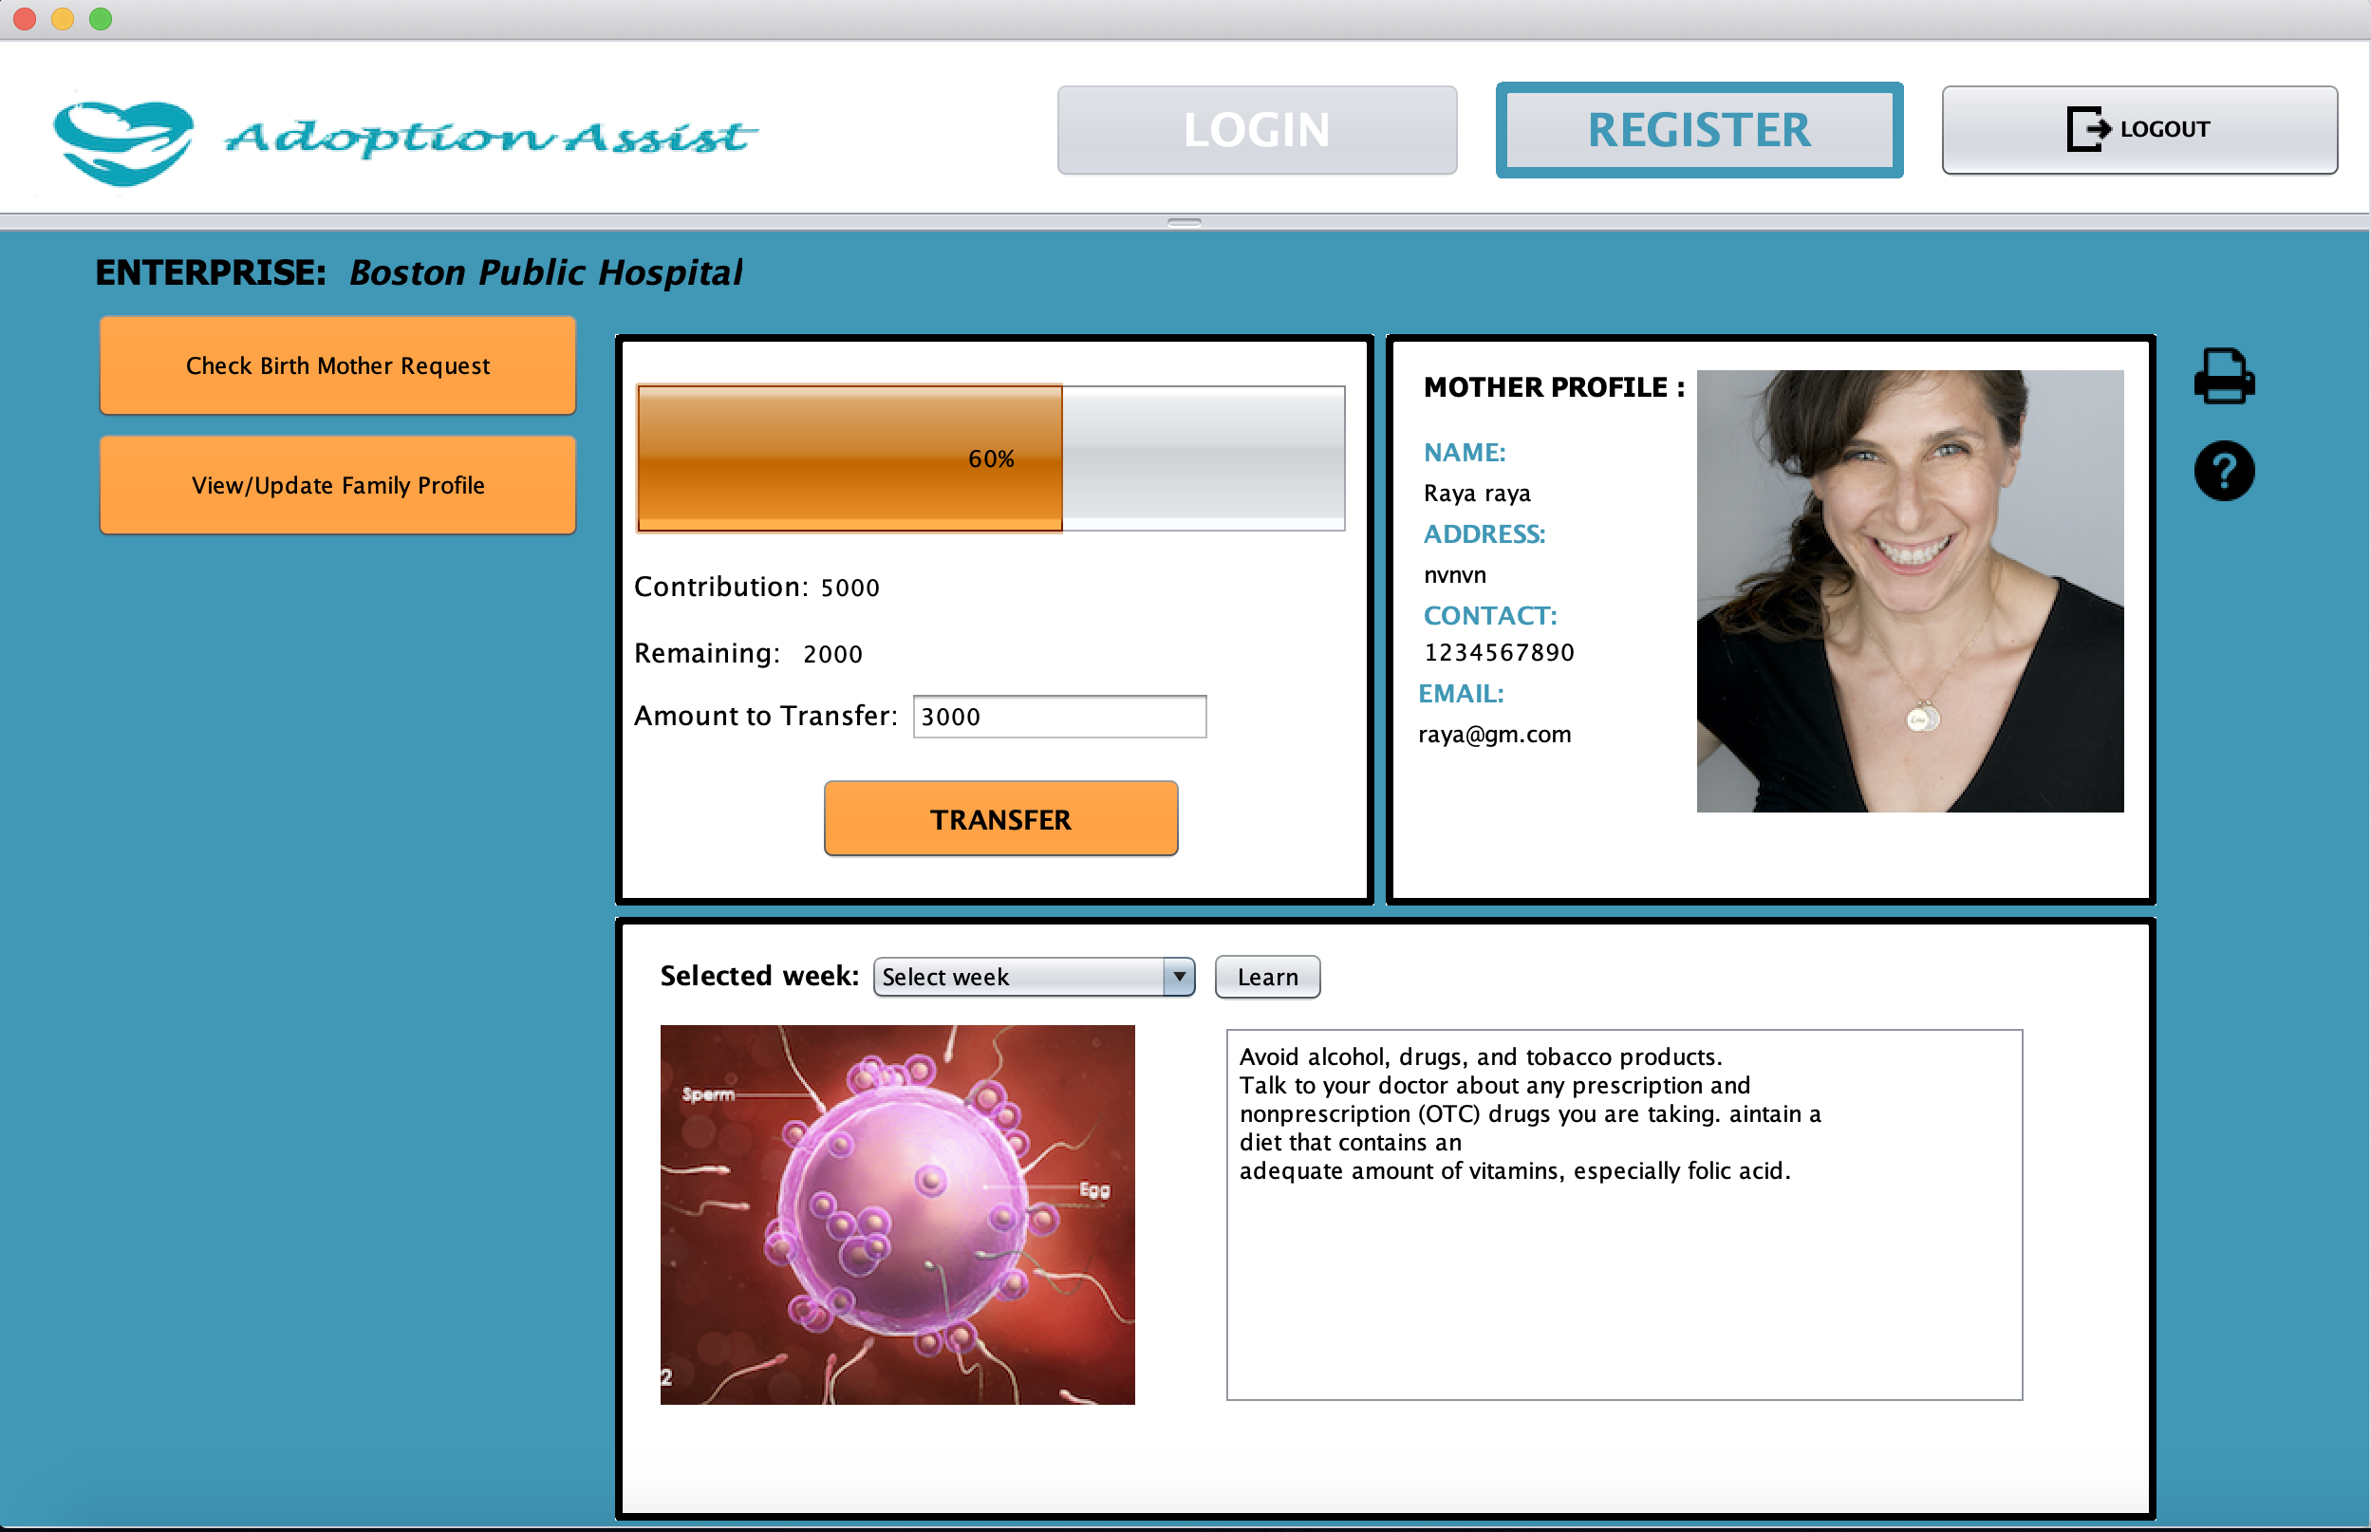

Slide 12
Bank Manager
Bank can approve/reject the mother applications received from the Admin, based on the financial documents provided by the mother at the time of application.
If the mother chooses to apply for a loan, the bank can also approve/reject their loan request based on the credibility of the application.
Bank can also approve/reject the account creation applications received from the Admin, and take the decision based on the financial documents provided by the Sponsor.
Once a Bank Account is registered with the bank, is selected for Loan, the Bank will also approve the loan for the mother’s application.

Slide 13
Counselor
Counselor meets the Birth Mother and then approves her request sending it to the Admin who creates her account in the system.
She is the primary person helping the Birth Mother to proceed with the Adoption process or Abortion portion according to her preferences
Counselor also approves the Parents to the system by the same process.

Slide 14
Unique features
Email Triggered from the application’s personalized Email id to the recipient's mail id
Pie Charts depicting the Financial Support provided to the Birth Mother
Dynamic Progress Bar set for transfering funds
Customized Dialog button with GIF icons enabled

